Slide 1
The Perils of Panel IV Estimation:
Revisiting the Causes of Conflict
Paul Christian (World Bank)
and
Christopher B. Barrett (Cornell)
Seminar at University of Notre Dame
November 15, 2018

Slide 2
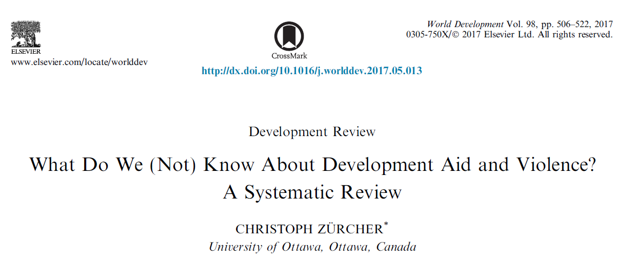
Background
Motivation
Identifying the causes of conflict is a social science question of 1st order importance. But clean ID of causal mechanisms, even of just reduced form relationships, is a challenge.
Recent systematic review found 9,413 relevant studies.
- Only 19 offered even a plausible causal identification strategy.
Only 5 address conflict in multiple countries over time using panel data, making
external validity plausible.
These panel IV studies are widely considered the state-of-the-art. But are they?

Slide 3
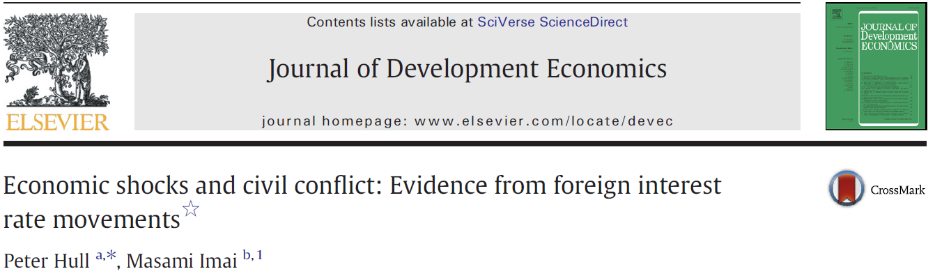
Example 1
Motivation
A panel IV strategy to identify what they claim is a causal effect of real GDP growth on conflict, using base country interest rate.
Substantive contribution: “a negative exogenous growth shock of four percentage points increases the unconditional probabil-ity of internal conflict by thirty percent for the typical country.”
Estimation strategy: Use 1st stage exogenous variation in base country real interest rates – interacted w/ exchange rate regime, capital account openness, ethnolinguistic fractionalization – as IV for endogenous GDP growth.

Slide 4
Example 2
Motivation
A panel IV strategy to identify what they claim is a causal effect of US food aid deliveries on conflict in recipient countries.
Substantive contribution: “a 1,000 MT increase in US wheat aid increases the incidence of conflict by .3 percentage points.” (~+4% avg conflict incidence at sample means). Very serious.
Estimation strategy: Use 1st stage exogenous variation in US wheat production – interacted with full-period frequency of food aid receipt – as shift-share (Bartik) IV for the endogenous variable of interest (food aid shipments).

Slide 5
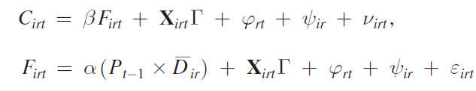
NQ Strategy
Estimate conflict as function of (endogenous) food aid receipts, given controls, incl. region-year and country fixed effects.
Policy generates random variation: “USDA accumulates wheat in high production years as part of its price stabilization policies. The accumulated wheat is stored and then shipped as food aid to poor countries.” Exogenous shocks to wheat production change food aid at margin, primarily among regular food aid recipients.
Identification:
“US wheat production is associated with more conflict among regular US food aid recipients but not among irregular recipients.”

Slide 6
Policy Motivation
Motivation: Food Aid Policy
The US is by far the largest global provider of food aid.
If US food aid causes conflict, further reduction of an already- controversial and diminished program might be warranted.
Sample coverage of NQ results:
“Cash for conflicts: New research suggests that development projects and food aid have fueled civil conflicts” (The Economist)
“Please, Don’t Send Food” (Foreign Policy)
“Why Food Aid Fuels International Conflict” (Huffington Post)
Meanwhile, UN warns that cuts to food aid are “threatening to worsen already unacceptable levels of acute malnutrition, stunting and anemia, particularly in children.”
So getting this right is important.

Slide 7
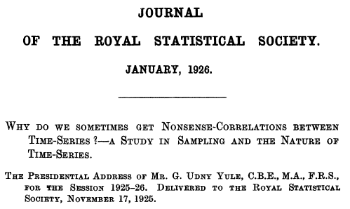

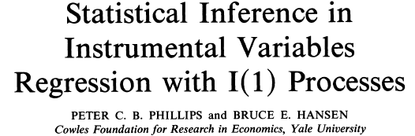
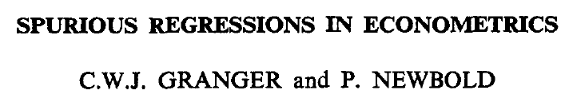
Methodological Motivation
Our claim: These and related panel IV papers are vulnerable to ‘spurious regressions’ problem long known in time series.
As we show, the problem in panel IV estimation is not just incorrect inference but also bias/inconsistency in 2SLS parameter estimates.
We offer 8 practical diagnostic steps to check whether a study is vulnerable to these oft-overlooked problems.

Slide 8
Methodological Motivation
Core issue:
Papers routinely ignore sequencing of observations. Thus, inadvertently identify parameter estimates off trends, not off exogenous perturbations to the instrument(s). But trends are short samples prone to spurious correlation. The relevance condition of the IV is satisfied by spurious regression.
Since errors are not iid, one over-rejects the zero-effect null.
In panel IV, this also turns into bias/inconsistency.
Interacted (e.g., Bartik) instruments don’t resolve the problem.

Slide 9
Talk Outline
Outline for rest of talk:
Panel IV w/o interacted instruments
  Correlations ignoring the time series
  Trends in sequenced observations
  Monte Carlo demonstration of inference problems with co-trending variables
  Cointegration and reverse causation
  First differencing to address nonstationarity
Do interacted instruments fix the problem?
Eight practical diagnostic steps for panel IV efforts

Slide 10
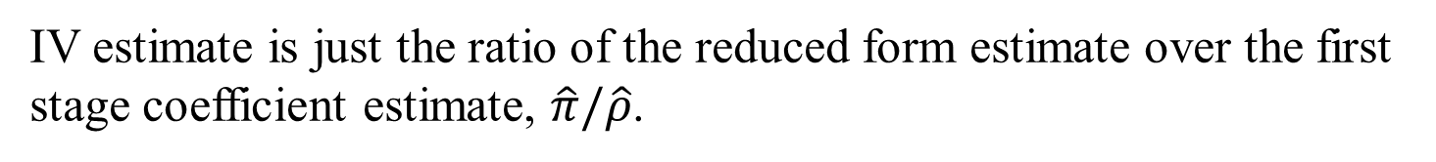


Estimation w/o shift-share instruments
Start by ignoring the interacted instruments so as to focus on the time series concern of spurious regressions.
The OLS regression:
Almost surely suffers endogeneity bias.
So estimate 2SLS, here shown in reduced and 1st stage form:
$Conflict_{it}=β∗X_{it}+ε_{it}$
$Conflict_{it}=πZ_{t}+ θ_{i}+δ_{i}∗t+ε_{it}$ $X_{it}=ρZ_{t}+ θ_{i}+δ_{i}∗t+ε_{it}$
IV estimate is just the ratio of the reduced form estimate over the first stage coefficient estimate, $\hat{π}/\hat{ρ}$.

Slide 11
Data
Preview: The N&Q Strategy
Replicate NQ (and HI) estimations using their stored data:
125 (97) non-OECD countries
36 (34) years
Binary conflict DV (=1 if ≥ 25 battle deaths in country-year)
Endogenous regressor: US wheat food aid shipments to country in that year (real GDP growth in country-year)
Instrument: lagged US wheat production (global real interest rate)
Lots of controls

Slide 12
Scatter plots
Preview: The N&Q Strategy
If we ignore sequencing of observations, this works for HI:
Conflict and real interest rates GDP growth and real interest rates
Positive reduced form/Negative 1st stage → negative IV

Slide 13
Scatter plots
Preview: The N&Q Strategy
If we ignore sequencing of observations, this works for NQ too:
Conflict and lagged US wheat output Food aid shipments and lagged US wheat output
Positive reduced form/Positive 1st stage → positive IV

Slide 14
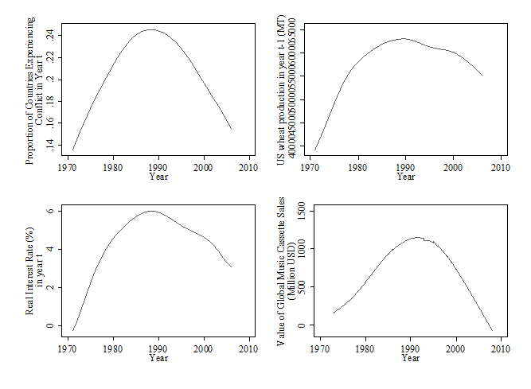
Trends
Preview: The N&Q Strategy
But when we sequence the observations and estimate trends nonparametrically, a common pattern emerges:
The dependent variable, HI and NQ instruments, and an obviously spurious variable (global audio cassette tape sales) exhibit the same inverted-U shape over the sample period.

Slide 15
Trends
Preview: The N&Q Strategy
And the endogenous regressors of interest likewise exhibit similar (or opposite) strong trends:
US wheat food aid shipments real GDP growth rates
The NQ (HI) endogenous regressor exhibits the same inverted-U (or its opposite, U) shape over the sample period.

Slide 16
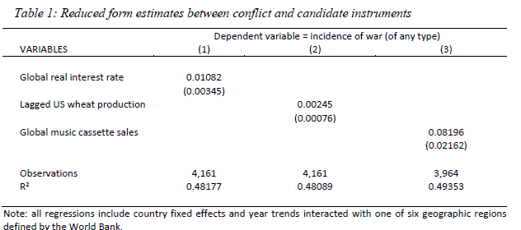
Trends
Preview: The N&Q Strategy
The reduced form (linear probability model) estimates confirm that any of the three variables are positively and statistically significantly associated with conflict.
In panel IV, any variable with a shared (or opposing) trend will be positively (negatively) associated w/DV.

Slide 17
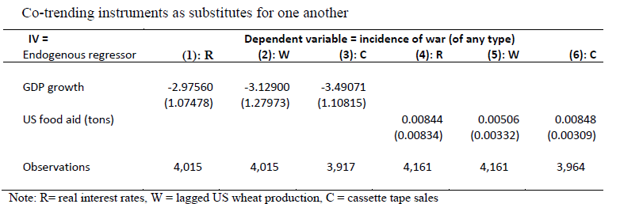
Trends
Preview: The N&Q Strategy
Co-trending variables indeed serve as good substitutes for one another. No matter which variable we use as the IV, we get statistically indistinguishable 2SLS estimates. Indeed, the ‘strongest’ instrument for NQ would be audio cassette tape sales!
How do we know which are spurious vs. truly causal?

Slide 18
Inferential problems
Time series literature on spurious regressions shows that traditional inference will over-reject the no-impact null hypothesis in the presence of co-trending variables (Yule 1926, Slutsky 1937, Granger & Newbold 1974, Phillips & Hansen 1990).
Demonstrate via Monte Carlo simulation:
1. Let an IV Z_{t} follow a random walk.
2. In yrs 1-36, using NQ conflict, food aid, and all controls, estimate
1st stage, reduced form, and 2SLS equations using the random,
nonstationary Z_{t} variable as IV for food aid.
3. Repeat steps 1-2 1,000 times, saving the coefficient estimates on
Z_{t}, the associated p-values, KP F-stat for weak instrument tests.

Slide 19
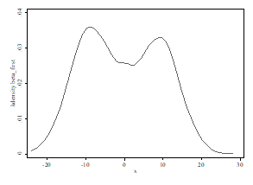
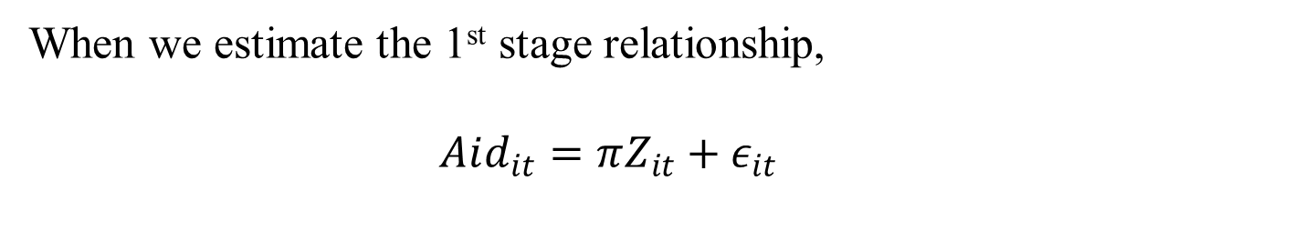
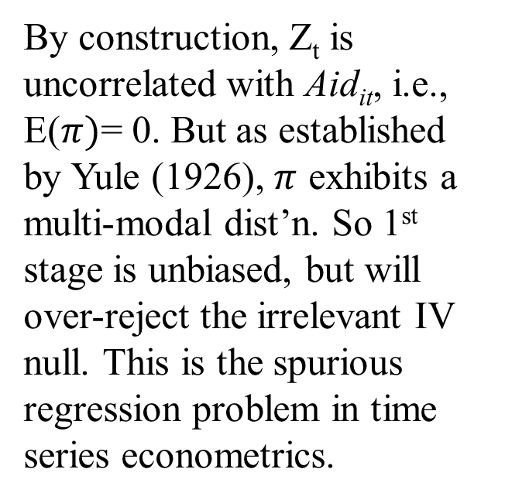
Inferential problems
When we estimate the 1st stage relationship,
$Aid_{it}=πZ_{it}+ε_{it}$
By construction, Z_{t} is uncorrelated with Aid_{it}, i.e., E($π)$= 0. But as established by Yule (1926), $π$ exhibits a multi-modal dist’n. So 1st stage is unbiased, but will over-reject the irrelevant IV null. This is the spurious regression problem in time series econometrics.

Slide 20
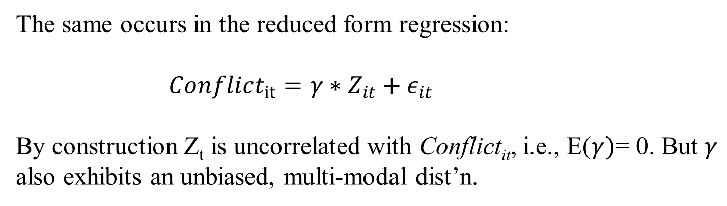
Inferential problems
The same occurs in the reduced form regression:
$Conflict_{it}=γ∗Z_{it}+ε_{it}$
By construction Z_{t} is uncorrelated with Conflict_{it}, i.e., E($γ)$= 0. But $γ$ also exhibits an unbiased, multi-modal dist’n.

Slide 21
Inferential problems
But the unbiasedness of the single regressions does not carry over to the IV estimate because the common cycling leads to positive correlation in the 1st stage and reduced form parameter estimates.
2SLS coefficient estimate distribution Reduced form vs. 1st stage estimates

Slide 22
Inferential problems
We get the exact same result for the MC simulation of the HI estimates, with the important difference that the countercyclical pattern in real GDP growth rates leads to a negative correlation of the 1st stage and reduced form estimates.
2SLS coefficient estimate distribution Reduced form vs. 1st stage estimates

Slide 23
The irony
The co-trending variables generate spurious correlation.
The irony is that the IV estimator is meant to remove possible reverse causality in the endogenous regressor. But with cointegrated series and reverse causality (i.e., lagged conflict induces food aid flows, as is stated US gov’t policy), the 2SLS estimate will be biased in the direction of the reverse causation between the dependent variable and the endogenous regressor! (See paper for the analytical derivation)
So spuriously correlated trends, which are routine in time series (Slutsky 1937), can bake in bias in the panel IV estimates.
Fundamental problem is unknown trends and non-iid errors.

Slide 24
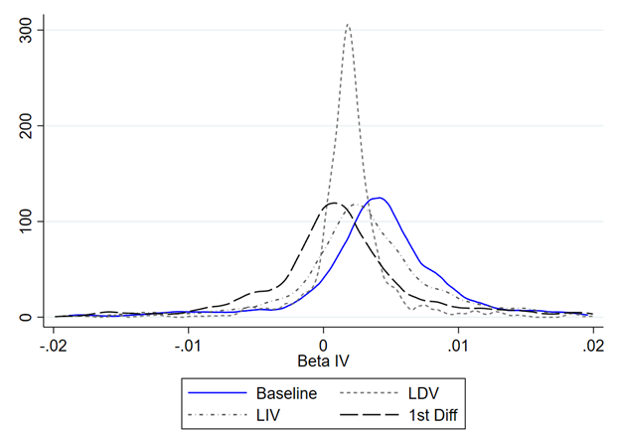
Controlling for lags
A natural response is to control for past realizations using LIV or LDV as regressors, or to first-difference if the variables are I(1).
But unless that happens to be the ARIMA structure, a spurious regression problem remains.
Now expand the Monte Carlo 2SLS simulation to test 3 more variants: (i) LDV, (ii) LIV, (iii) first differences. LDV/LIV only work if they match the true ARIMA process. Only 1st diff works b/c corrects nonstationarity.
The 1st diff regressions are insign. (and negative in NQ, not positive).

Slide 25
Adding shift-shares
NQ and HI both interact the time series instrument – US wheat production or real interest rates in the base country – with a cross-sectional variable, D_{i}, meant to reflect differential exposure to the exogenous (instrumented) component of the endogenous regressor.
This strategy allows for a more flexible (nonparametric) time trend and controls for time trends common to countries w/same D_{i}.
But as Goldsmith-Pinkham et al. (2018) show, unless D_{i} satisfies the exclusion restriction, the Bartik-style instrument boosts power but does not solve the causal identification challenge in panel IV.

Slide 26
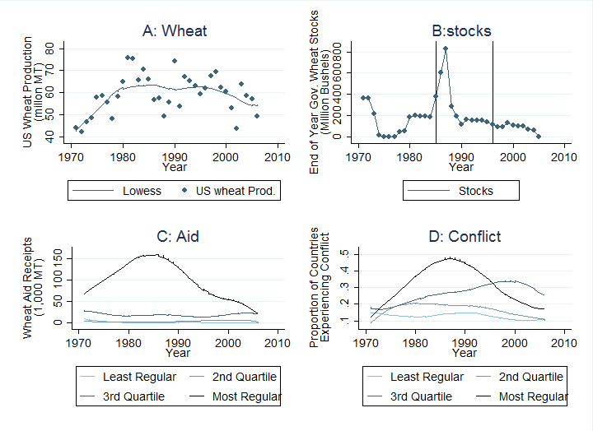
Decomposing interacted trends
The NQ identification strategy and trends visualized

Slide 27
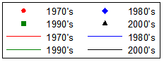
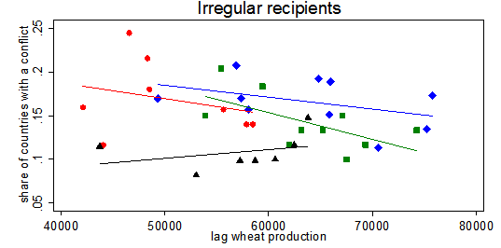
Potential problem
Preview: The Problem
The difference between regular (D≥.3) and irregular (D<.3) recipients occurs solely in the 1970s, during transition to period of high US wheat output and conflict.

Slide 28
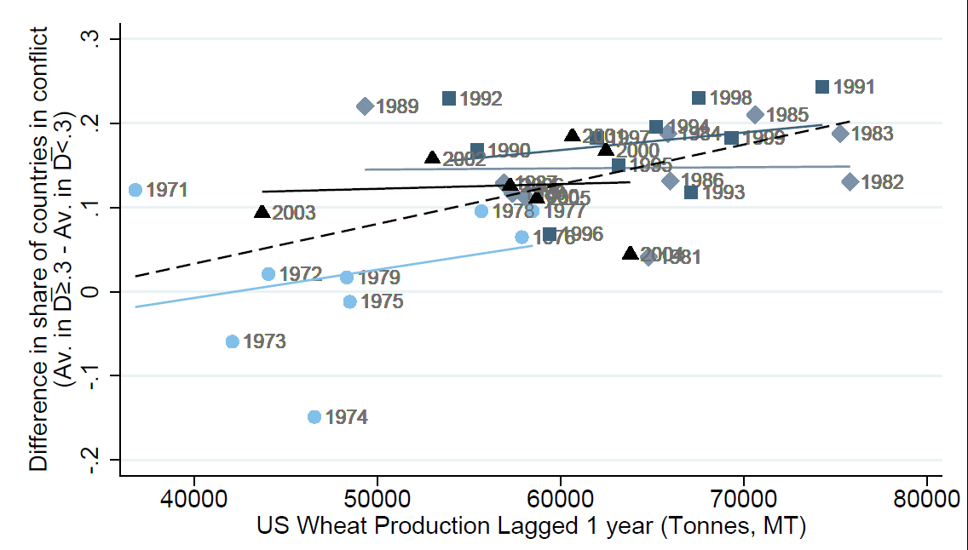
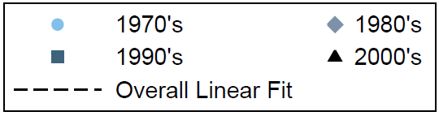
Potential problem
Most easily seen by looking at the differences between regular and irregular recipients by decade.

Slide 29
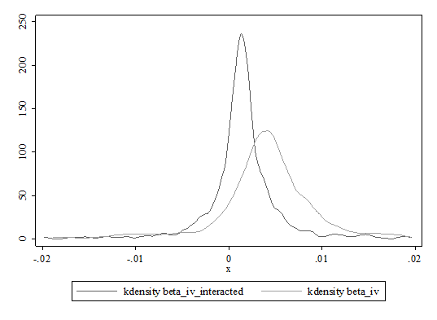
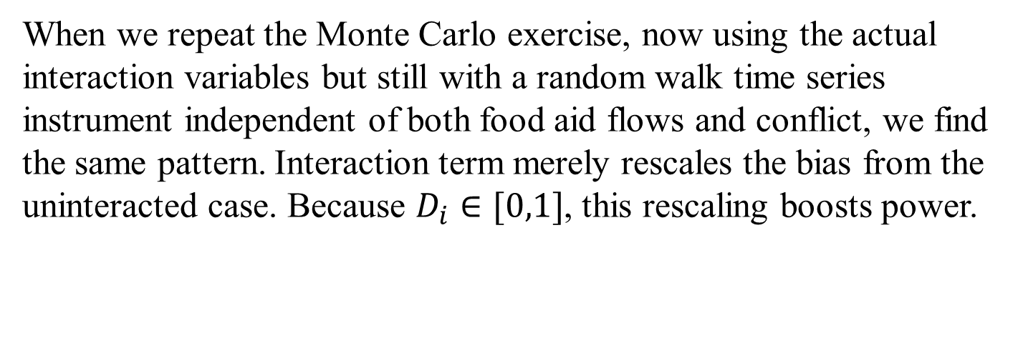
Back to Monte Carlo
When we repeat the Monte Carlo exercise, now using the actual interaction variables but still with a random walk time series instrument independent of both food aid flows and conflict, we find the same pattern. Interaction term merely rescales the bias from the uninteracted case. Because $D_{i}∈[0,1]$, this rescaling boosts power.
2SLS coefficient estimate distribution, w/ and w/o shift-share interaction

Slide 30
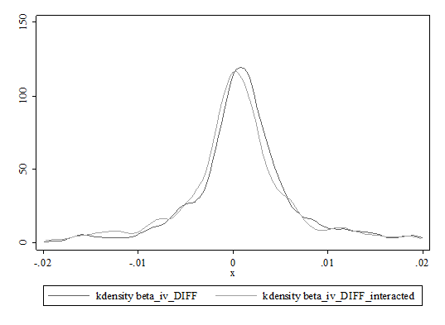
Back to Monte Carlo
And when we first difference to remove the spurious correlation in the time series, we again eliminate bias. But the interaction term in the IV no longer adds power.
2SLS coefficient estimates, w/ and w/o shift-share interaction (1st diff)

Slide 31
Key takeaways
Key takeaways from these sections:
The sequencing of observations in a panel risks spurious regressions problems if one doesn’t address non-iid errors. Leads not only to over-rejection of null hypotheses but also to bias.
W/cointegrated variables, the IV attempt to obviate reverse causality leads to bias with the sign of the reverse causal relationship … bakes in, rather than resolves, problem.
More sophisticated interacted instruments merely rescales the problem but doesn’t resolve it.
As a result, panel IV claims of causal inference are suspect.

Slide 32
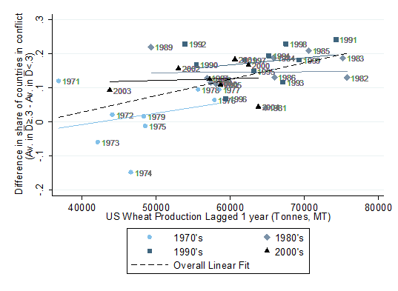
8 practical diagnostic steps
Cautions not withstanding, panel IV may still offer the best option for causal identification. But one needs careful diagnostics.
Step 1: Carefully visually inspect the data. This involves more than scatter plots; look at trends and sub-trends. Where does the identifying variation come from in the data? Example:
Linear Trends in the Difference Between Average Civil Conflict Incidence for Countries with D≥0.3 and Countries with D<0.3 (Regular minus Irregular Aid Recipients) by Decade

Slide 33
8 practical diagnostic steps
Step 2: Identify causal mechanism(s)/instrument(s); if possible, run placebo tests. Real danger of spurious regressions based on seemingly-relevant instruments.
In NQ: evolving policy creates natural placebo test of hypothesized mechanism.
1970s-early 1980s: Policy more or less as described by NQ
  Wheat farmers supplied with non-recourse loans backed by their wheat production as collateral. Serve as de facto price floor. Rarely binding.
  Food aid disposes of occasional gov’t-held surpluses.
1985-1996: Prices near loan rates, gov’t builds stocks, raising costs and prompting major policy changes
  Sever the link between prices and CCC purchases
  Farm bills first change prices for NR loans
  1996 farm bill formally severs the link for once and for all
1996-2006: No direct link between production and food aid purchases
Food aid now open market procurement, not surplus disposal

Slide 34
Placebo test 1
Re-estimate for each sub-period, corresponding to policy breaks.
1st stage instrument becomes insignificant in relevant (pre-1985) period; 2SLS estimate unchanged (but insig).
But placebo test period (post-1996) not stat sig different from relevant (pre-1985) period.
Failed placebo test signals that the hypothesized mechanism isn’t driving observed correlation.

Slide 35
8 practical diagnostic steps
Step 3: Run the OLS regression and identify most likely direction of bias.
NQ OLS results: negative, insignificant relationship b/n food aid flows - conflict.
But potentially endogenous if food aid flows targeted partly on basis of conflict status (per policy). Positive selection bias.
N&Q argue that OLS estimates are downwardly biased because food aid is targeted to countries less affected by conflict (where it is least likely to cause harm). ??????

Slide 36

8 practical diagnostic steps
Step 4: Estimate 2SLS regression. Does the parameter change as hypothesized?
Given concerns of bias in OLS estimates, it is natural to attempt an IV solution.
Crucial, however, to critically assess whether the direction of change from the (potentially biased) OLS estimate to the 2SLS estimate is consistent with the hypothesized mechanism(s) generating bias in the OLS estimate.
Problem: US policy is: “[USAID Food for Peace] provides emergency food assistance to those affected by conflict and natural disasters and provides development food assistance to address the underlying causes of hunger.” (2015, emphasis added) So OLS bias should be upward.
Furthermore, food aid flows persist, esp. in places that may need emergency assistance. This makes exposure variable endogenous.

Slide 37
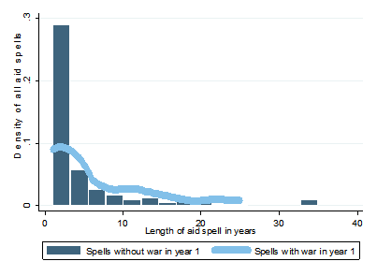
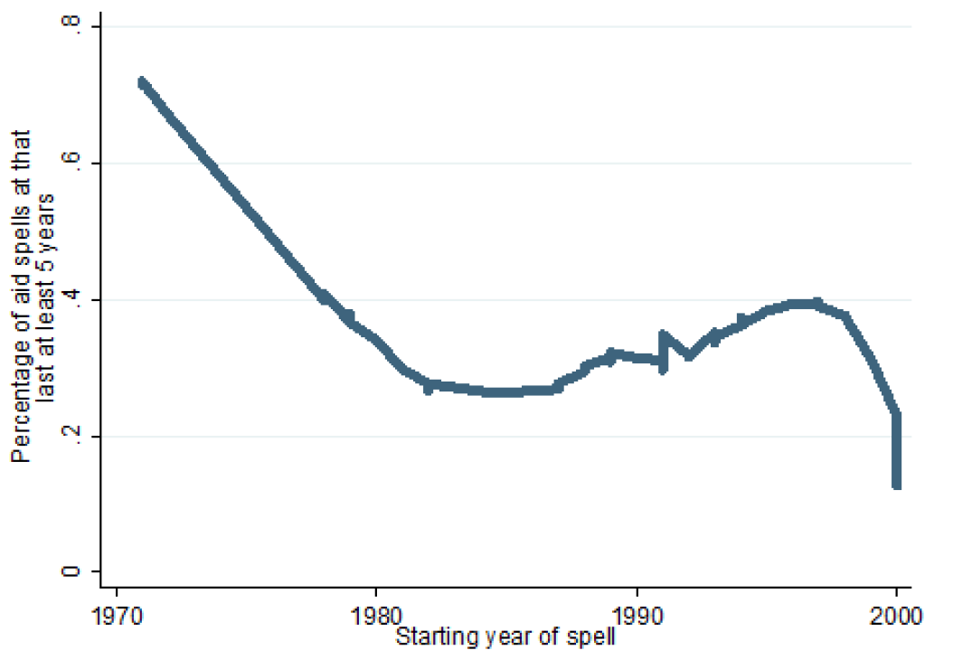
8 practical diagnostic steps
Step 4: Estimate 2SLS regression. Instrument valid?
In interacted IV, is D really excludable? Might it suffer non-random selection?
Food aid flows persist, esp. if a food aid spell begins in a year of conflict. [Note: NQ find no effect on conflict initiation, only on duration.]
Selection bias if food aid is targeted to conflict-affected countries. Persistence falls over study period, so problem greatest in 1970s (when group diffs exist).

Slide 38
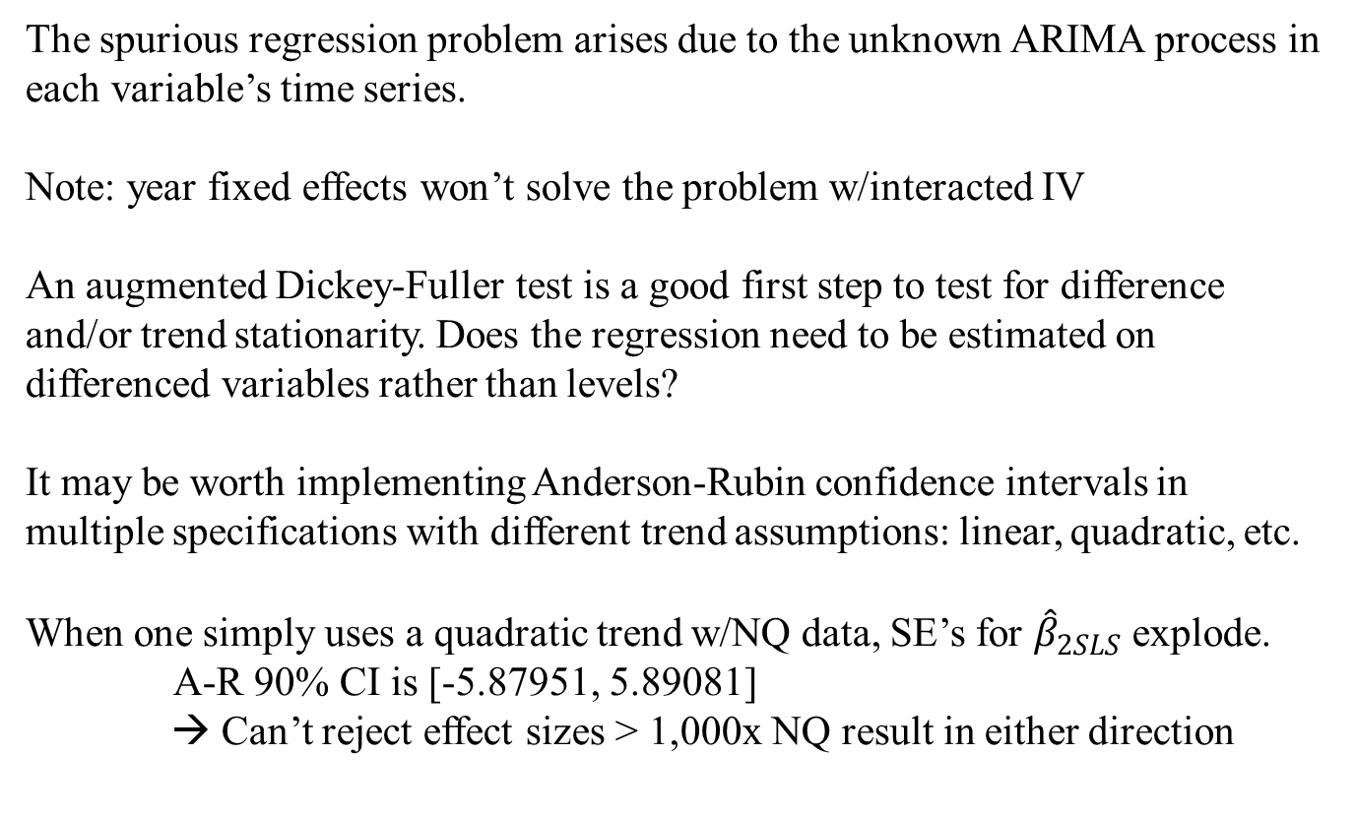
8 practical diagnostic steps
Step 5: Check trend assumptions and nonstationarity
The spurious regression problem arises due to the unknown ARIMA process in each variable’s time series.
Note: year fixed effects won’t solve the problem w/interacted IV
An augmented Dickey-Fuller test is a good first step to test for difference and/or trend stationarity. Does the regression need to be estimated on differenced variables rather than levels?
It may be worth implementing Anderson-Rubin confidence intervals in multiple specifications with different trend assumptions: linear, quadratic, etc.
When one simply uses a quadratic trend w/NQ data, SE’s for ${\hat{β}}_{2SLS}$ explode. A-R 90% CI is [-5.87951, 5.89081]
  → Can’t reject effect sizes > 1,000x NQ result in either direction

Slide 39
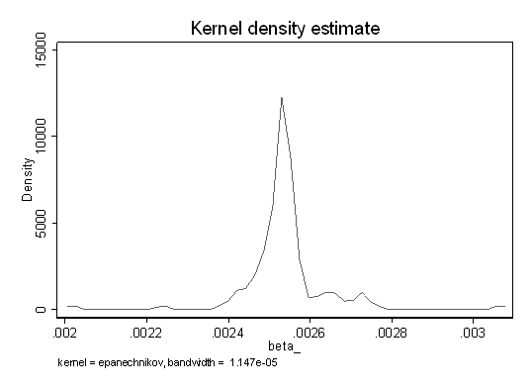
8 practical diagnostic steps
Step 6: Run Young’s bootstrap test for overleveraged observations
Related Young (2018) concern about over-rejection of null in IV estimation.
That problem arises from over-leverage of observations (or clusters). Complement to our concern about trends.
NQ pass Young’s test
Dropping one country at a time, p-value = 0.048
Dropping one year at a time, p-value = 0.018
Over-leverage not an issue.

Slide 40
8 practical diagnostic steps
Step 7: Check the instrument using a randomization placebo test
Evaluate the hypothesized causal mechanism using a randomization placebo test.
Placebo test: randomize the endogenous regressor values among cross-sectional units within a time period. This should break the hypothesized causal link unless the correlation is driven by something else.
If coefficient estimate on randomized food aid is still positive and statistically significant, it is likely picking up something else, (i) endog. identity of regular aid recipients and (ii) spurious regressions in time series

Slide 41
Placebo test #2
Placebo Test Method:
- Hold constant identity of aid recipients, timing and total availability of food aid, wheat production, etc.
- Randomize which country receives food aid flow each year.
- This preserves the macro time trends and the potential spurious correlation of US wheat production and recipient country conflict.
- Also retains potential ORV and selection bias problems.
Implication:
If N&Q’s hypothesized mechanism is true, this randomization should break correlation between food aid flows and conflict.

Slide 42
Placebo test #2
Dist’n of coefficient estimates from 1,000 randomizations does not center around 0. Instead, it moves rightward with no support around 0!
Implication:
NQ result does not arise from the policy mechanism they posit. Indeed, randomized estimates higher, consistent w/neg OLS and positive selection bias.

Slide 43
8 practical diagnostic steps
Step 8: Monte Carlo simulation when the mechanism is missing or opposite
Build a known data generating process that lacks the hypothesized causal mechanism … or even has the opposite causal mechanism. See whether the pattern of 2SLS estimates remains nonetheless.

Slide 44
Monte Carlo tests
We construct 2 models where food aid has no positive effect on conflict: (i) uncorrelated, and (ii) food aid reduces conflict.
If we preserve the background trends, and L-R variation > S-R variation in exogenous component of IV, do we estimate the same negative OLS but positive IV relationship?
In such a model, does NQ’s estimation strategy accurately reflect the true DGP?
Take-away:
We consistently replicate NQ’s findings of negative OLS estimates and positive 2SLS estimates when there is no true positive, causal effect of food aid on conflict. Even do so when food aid truly, causally reduces conflict.

Slide 45
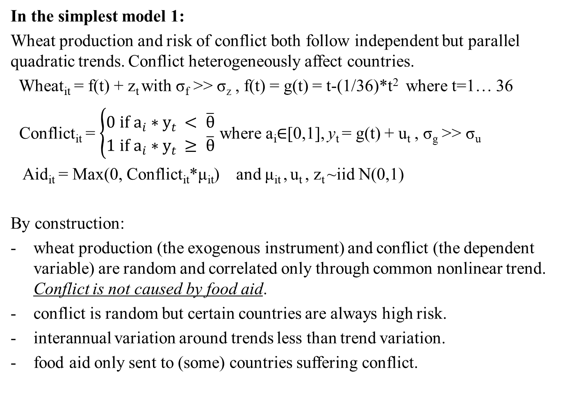
Monte Carlo tests
In the simplest model 1:
Wheat production and risk of conflict both follow independent but parallel quadratic trends. Conflict heterogeneously affect countries.
Wheat­_{it} = f(t) + z_{t} with σ_{f} >> σ_{z} , f(t) = g(t) = t-(1/36)*t² where t=1… 36
Conflict_{it} = $\left\{\begin{matrix}0 if a_{i}∗y_{t} < \overline{θ} \\ 1 if a_{i}∗y_{t} ≥ \overline{θ}\end{matrix}\right.$ where a_{i}$∈$[0,1], y_{t} = g(t) + u_{t} , σ_{g} >> σ_{u}
Aid_{it} = Max(0, Conflict_{it}*μ_{it}) and μ_{it} , u_{t} , z_{t} ~iid N(0,1)
By construction:
wheat production (the exogenous instrument) and conflict (the dependent variable) are random and correlated only through common nonlinear trend. Conflict is not caused by food aid.
conflict is random but certain countries are always high risk.
interannual variation around trends less than trend variation.
food aid only sent to (some) countries suffering conflict.

Slide 46
Monte Carlo tests
When we generate 100 random samples of 126 countries and 36 years, we get the following key variables:
Conflict is random but certain
countries are always high risk
risk is high in middle period
Wheat yield also follows an
inverse-U shape with little
variation around the trend

Slide 47
Monte Carlo tests
Despite true β=0, N&Q’s 2SLS estimation strategy generates biased sampling dist’n of the parameter estimates of interest:
Main robustness check (including lagged conflict status) actually makes the bias worse.

Slide 48
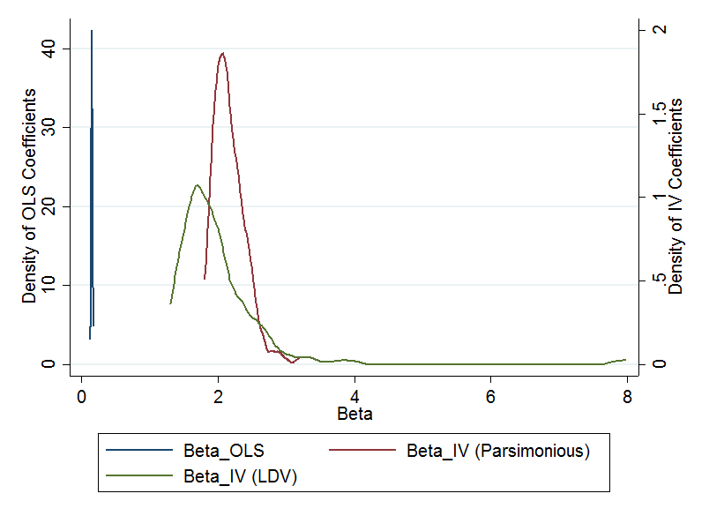
Monte Carlo tests
Model 2: allow food aid to be driven partly by reasons other than conflict. Also let food aid prevent conflict in the true DGP.
Resulting parameter estimates for OLS and 2SLS qualitatively Identical to NQ’s even though true β<0!
Two core problems: (i) countries that experience the most conflict are most likely to get aid and (ii) conflict and US wheat production are spuriously correlated over time.

Slide 49
Conclusions
Food aid: NQ findings not causal. Indeed, fully consistent w/ a model in which food aid prevents rather than causes conflict.
Methodological: Other papers use similar IV strategy: interact a plausibly exogenous time series variable with limited variation with a potentially endogenous cross-sectional variable with greater N to create quasi-DID panel IV estimator. Be wary!
The spurious regressions problem is a serious threat to causal identification in panel IV estimation.
Clever, interacted instruments don’t solve the problem.

Slide 50
Thank you for your interest and comments!
pchristian@worldbank.org
cbb2@cornell.edu

